Slide 1
LEVEL 2 · 4
MISSION BRIEFING
Conjugate of a
Complex Number
Every complex number has a mirror twin across the real axis. In this quest you'll learn to find it, prove its properties, and use it to conquer division problems.
Concept
Formulas
Solved Sum
Visual Quest
Boss Challenge
XII MATHEMATICS • CHAPTER 2 • COMPLEX NUMBERS

Slide 2
1
WHAT IS A CONJUGATE?
The Concept
Definition The conjugate of x + iy is x − iy. Simply flip the sign of i.
THINK OF IT LIKE...
A pond reflection
1
Notation
The conjugate of z is written z̄ (read "z bar").
z
2
Geometric meaning
z̄ is the mirror image of z, reflected across the real axis.
Real axis
z̄
3
Superpower
z multiplied by z̄ always gives a real number — useful for division!
Same distance from the real axis — one above, one below.
Quick check: z = 2 − 5i → z̄ = 2 + 5i
XII MATHEMATICS • CHAPTER 2 • COMPLEX NUMBERS

Slide 3
2
COLLECT YOUR POWER-UPS
Properties of Conjugates
1
2
3
4
5
conj( z1 + z2 ) =
conj( z1 − z2 ) =
conj( z1 · z2 ) =
conj( z1 / z2 ) =
Re(z) =
z̄1 + z̄2
z̄1 − z̄2
z̄1 · z̄2
z̄1 / z̄2 (z2 ≠ 0)
(z + z̄) / 2
6
7
8
9
10
Im(z) =
conj( zⁿ ) =
z is real ⇔
z is imaginary ⇔
conj( z̄ ) =
(z − z̄) / 2i
(z̄)ⁿ
z = z̄
z = −z̄
z
Tip: properties 1–4 and 7 hold for sums, products, quotients and powers — conjugation "distributes" through every basic operation.
XII MATHEMATICS • CHAPTER 2 • COMPLEX NUMBERS

Slide 4
3
SOLVE THE QUEST
Worked Example
Quest: For z = 4 + 7i, find z̄ and verify that Re(z) = (z + z̄) / 2.
1
Step 1 — Find the conjugate
Flip the sign of i: z = 4 + 7i → z̄ = 4 − 7i
✓
2
Step 2 — Add z and z̄
z + z̄ = (4 + 7i) + (4 − 7i) = 8
QUEST COMPLETE!
+10 XP
3
Step 3 — Divide by 2 and compare
z̄ = 4 − 7i
(z + z̄)/2 = 8/2 = 4 = Re(z) ✓ Verified!
Re(z) confirmed equal on both sides
XII MATHEMATICS • CHAPTER 2 • COMPLEX NUMBERS

Slide 5
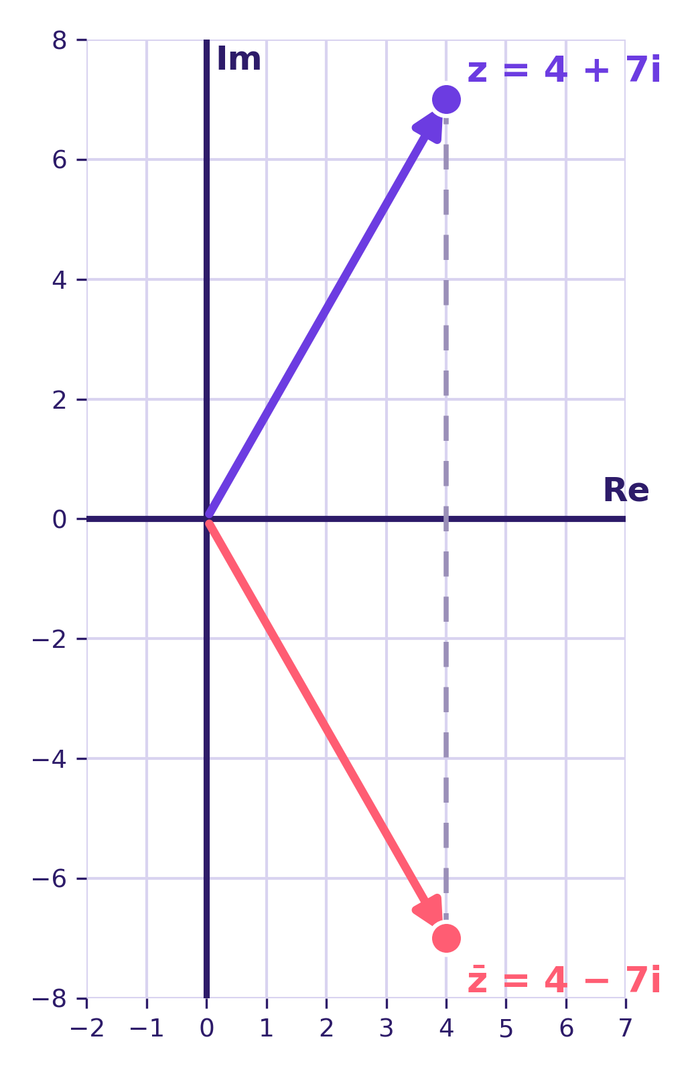
4
ENTER THE MIRROR REALM
Geometric Picture
1
Plot z = 4 + 7i as an arrow from the origin.
2
Its conjugate z̄ = 4 − 7i sits the same distance below the real axis.
3
The real axis acts like a mirror — reflecting z straight down to z̄.
4
Both points always share the same real part.
XII MATHEMATICS • CHAPTER 2 • COMPLEX NUMBERS

Slide 6
LEVEL COMPLETE
Recap & Boss Challenge
Definition
Geometry
10 Properties
Flip the sign of i: x+iy → x−iy
z̄ is the reflection of z across the real axis
Conjugation distributes over +, −, ×, ÷, powers
BOSS CHALLENGE
Find z̄ for z = −6 + 2i, then check whether z is purely imaginary.
Hint: flip the sign of i for the conjugate, then use property 9 — z is purely imaginary if and only if z = −z̄.
XII MATHEMATICS • CHAPTER 2 • COMPLEX NUMBERS

